Slide 1
Introduction to Refrigerant R-454B
October 2023
Original Authors: Mark Petty & Sol Irvine

Slide 2
Introduction to R-454B
The material in this presentation is focused on the change from R-410A to R-454B refrigerant in Ducted Systems products and the impact to manufacturing, distribution and HVAC contractors.
Dates included in the presentation are intended to serve as a reminder of the compressed timeline for refrigerant change.
The material is not comprehensive – several items remain in flux right now, especially at the local level.
Economic, political, social or other non-technical topics are not addressed by the presentation.
Notes:
There’s a bunch of “noise” surrounding refrigerant change – we don’t want to amplify that noise. We’re taking an “it is what it is” tone for this presentation.

Slide 3
GWP drives R-410A to R-454B change
GWP = Global Warming Potential
A lower GWP number indicates less “greenhouse gas” affect
R-410A has a GWP rating of 2088
R-454B has a GWP rating of 467
Notes:
R-454B has a GWP of 466 or 467 depending on rating method; the higher 467 GWP rating is used throughout this presentation

Slide 4
Regulations Impacting Manufacturing – International
Kigali Amendment to the Montreal Protocol – effective in 2019, an international agreement to:
Transition to lower global warming potential (GWP) refrigerants.
“Phasedown” HFC [R-410A] production and consumption
Has been ratified by 90+ countries including Canada
Ratified by the U.S. 10/31/2022
Notes:
At this time, US ratification was less than a year ago

Slide 5
Regulations Impacting Manufacturing – North America
Canada: Ozone-Depleting Substances and Halocarbon Alternatives Regulations (ODSHAR) Amendments
“Phasedown” of HFC [R-410A] production and consumption per the Kigali Amendment
Set a 2000 GWP limit for refrigerants used in residential and light commercial HVAC
United States: American Innovation and Manufacturing (AIM) Act – signed into law 11/27/2020
“Phasedown” of HFC [R-410A] production and consumption similar to the Kigali Amendment
Set a 750 GWP limit for refrigerants used in residential and light commercial HVAC manufactured 1/1/2025 and later
Notes:
Some of the phasedown supply/demand is already affecting R-410A cost. 2000 GWP limit in Canada eliminates R-410A use. R-454B is well below the US GWP limit

Slide 6
Regulations Impacting Manufacturing
Ducted Systems will not manufacture R-410A products after 12/31/2024; will begin phase-in of R-454B products prior to the cut-off date
  Later in the presentation: the AIM Act (US) also has provisions that impact distribution and contracting
  Canada: Beside the change to R-454B, ODSHAR amendments do not address distribution and HVAC contracting practices
    There are other industry regulations that parallel much of the discussion of US regulations
Notes:
Though dates are not firm, R-454B products will be available in early 2024

Slide 7
Why R-454B? or Flammability: the elephant in the room
Suitable low GWP A/C refrigerants are listed as flammable refrigerants
R-454B has favorable flammability characteristics compared to other low GWP refrigerants
Factors of GWP, performance, industry acceptance, etc. were also weighed in choosing R-454B
Notes:
“Suitable” term: availability, has supporting technology, etc. Industry acceptance is significant for R-454B component availability

Slide 8
R-454B Flammability Information
R-454B is in ASHRAE Safety Group A2L (A2L refrigerant) – a relatively new category for “mildly flammable” refrigerants
A
Non-Toxic
For the A2L safety group: The Heat of Combustion (HOC) must be less than 8169 BTUs/lb
R-454B HOC: ≈ 4342 BTUs/lb
2
Flammable
L
Low burning velocity; less than 3.9 in/sec (10 cm/sec)
R-454B has a burning velocity of 2.0 in/sec (10 times slower than ethanol)
Notes:
Ethanol used for comparison since everyone has seen an example of an alcohol flame. R-454B burns slowly and has low heat content – is not an energetic fuel, unlikely to be explosive

Slide 9
More R-454B Flammability Information
A mix of R-454B vapor and air is only combustible in a relatively narrow range
The Lower Flammability Limit and Upper Flammability Limit bracket the concentrations of R-454B vapor in air where combustion is possible
  Concentrations below the Lower Flammability Limit are too lean to support combustion
    R-454B Lower Flammability Limit: 11.25% (volume) Method: ASTM E681
  Concentrations above the Upper Flammability Limit are too rich to support combustion
    R-454B Upper Flammability Limit: 22% (volume) Method: ASTM E681
Key concept: Lower Flammability Limit – This will come up later in the discussion of refrigerant leak sensing and application factors.
Notes:
It is difficult to get a combustible mix of R-454B & air. The test method is included since there is some variability to LFL & HFL numbers (altitude, stirred air, etc.) – later addressed by the UL safety factor for LFL. Percentages, rather than ounces R-454B per cubic foot of air, used here for clarity/simplicity

Slide 10
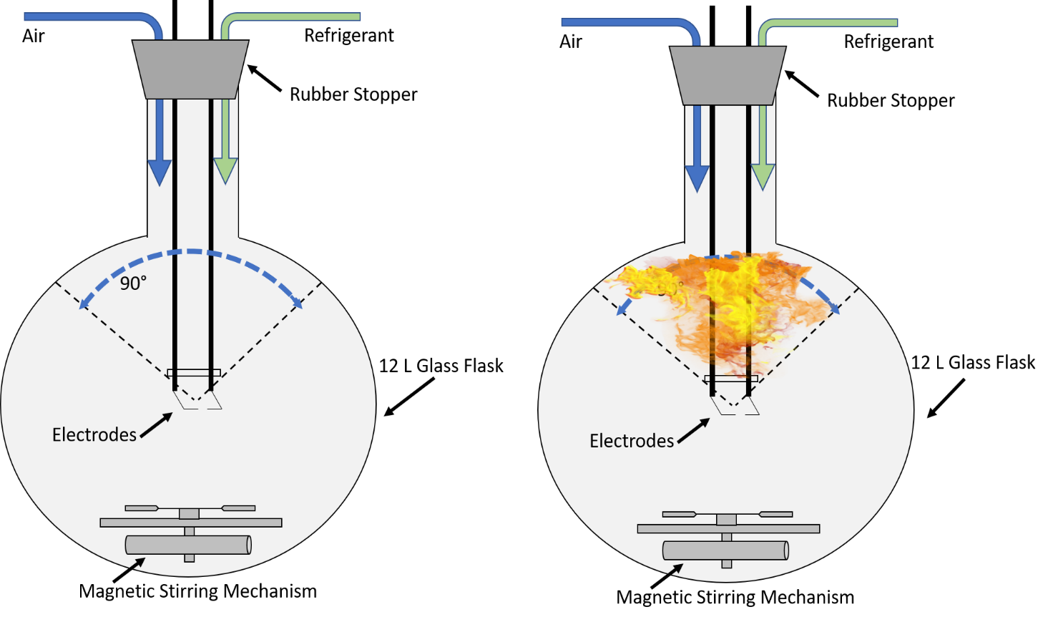
R-454B Flammability Information
Refrigerant flammability is rated by the ASTM E681 test
At 140°F, refrigerant and air mixed in a flask with an ignitor
Flame spread less than 90° from ignitor
Considered to have “no flame propagation”
Class 1, non-flammable rating
Flame spread more than 90° from ignitor
Class 2 (or higher), flammable rating
Class 2L, lower flammability rating if also has low burning velocity & low heat of combustion
Flame spread more than 90° from ignitor and has high burning velocity or high heat of combustion
Class 3, higher flammability rating
Notes:
Note: Graphics masked; seen as slideshow advances. Yes, a “non-flammable” refrigerant is combustible if conditions align. A2L refrigerants just cross the line to a flammable rating. (believe the A3 image to be from a propane test)

Slide 11
More R-454B Flammability Information
A combustible mix of R-454B vapor and air has an ignition temperature above 1472°F (800°C)
Requires an open flame or “high energy ignition source” to ignite
Static electricity discharge, toaster, or hair dryer – listed as 400°C or less ignition sources – typically cannot ignite a combustible mix of R-454B vapor and air
Notes:
While R-454B is a poor fuel, it is still labeled as flammable and requires elevated awareness

Slide 12
More R-454B Flammability Information
If a combustible mix of R-454B vapor and air ignites:
Caution: The faint blue flame may not be easily visible in bright light.
Hazardous combustion products: hydrogen fluoride, carbonyl fluoride, carbon oxides, fluorine compounds
Similar (if not the same) noxious chemicals produced by burning R-410A
Extinguished by: water spray, alcohol-resistant foam, carbon dioxide (CO2), dry chemical
Most practical recommendation: carry general-purpose, Class A-B-C dry chemical fire extinguishers
  DOT requirement for fire extinguisher in the vehicle transporting flammable gases
  At location of installation and service
Notes:
Fire extinguisher comes up often in the presentation. A-B-C dry chemical recommended since these are readily available & low cost; electrical and other field needs for a fire extinguisher are covered

Slide 13
Other R-454B properties
Generic name: Refrigerant R-454B
Chemours trade name: Opteon™ XL41
Carrier trade name: Puron Advance™
Hydrofluro-olefin (HFO) based refrigerant
Also described as an HFO/HFC refrigerant
POE oil used for compressor lubrication
Composition: 68.9% R-32, 31.1% R-1234yf
R-32 is half of R-410A, R-1234yf is an automotive A/C refrigerant
Ozone Depletion Potential (ODP): 0
Global Warming Potential (GWP): 467

Slide 14
R-454B and “phasedown” Regulations
R-454B is subject to “phasedown” regulations
Despite the “hydrofluoro-olefin based” and “HFO/HFC” naming
The HFC R-32 component of R-454B is named in the “phasedown” regulations
Notes:
The HFO/HFC label doesn’t avoid phasedown requirements.

Slide 15

Dew Point, Bubble Point & Temperature Glide
R-454B & Other Blended Refrigerants
Both refrigerant components completely boiled at temps above Dew Point
ALL VAPOR
Dew Point
Condensation begins with temps falling to Dew Point
Temperature Glide: Temp range between Dew Point and Bubble Point where refrigerant components are in a mix of vapor and liquid
Boiling begins with temps rising to Bubble Point
Bubble Point
Both refrigerant components completely condensed at temps below Bubble Point
ALL LIQUID
Notes:
Temperature Glide introduces some uncertainty to determining the actual coil temp

Slide 16
Other R-454B properties
Temperature Glide @ 45°F evaporator: 2.35°F
Use dew point data for calculation of superheat
Temperature Glide @ 105°F condenser: 2.3°F
Use bubble point data for calculation of subcooling
Charge can be “topped-off” – fractionization is not an issue
R-454B vapor density is 2.2 times heavier than air
Notes:
Temperature glide is low [just not as low as the 0.5 degree or less with R-410A] and introduces few real issues under field conditions

Slide 17
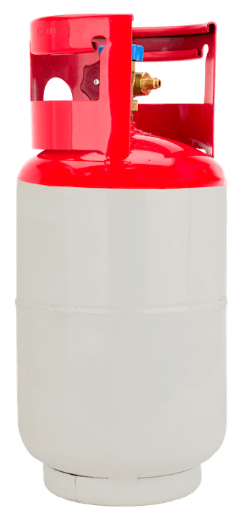

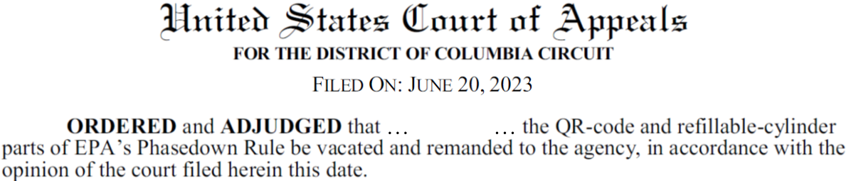
Other R-454B properties
R-454B Cylinders
Red stripe or top to indicate flammable
Pop-off relief valve rather than rupture disk
  Minimized release for burst prevention
  Upright storage and transport so the pop-off valve is in the vapor section of the cylinder
Cylinders are expected to have left-hand thread connections
  Note: the AIM Act also requires use of refillable and trackable refrigerant cylinders; details TBD
    Disposable cylinders will not be produced after 12/31/2024 or sold after 12/31/2026
Notes:
May need to change service truck racking for upright transport. Strike-thru, rather than removal, of earlier statement due to recent court decision (also later on slide 36)

Slide 18
R-454B Compared to R-410A
R-454B has 82.3% of R-410A mass flow (lb/min/ton)
 | R-454B | R-410A
0 psig | -57.09°F | -60.46°F
40°F | 107 psig | 118.4 psig
45°F | 117.8 psig | 130.1 psig
50°F | 129.3 psig | 142.6 psig
95°F | 270.4 psig | 295.4 psig
110°F | 335.2 psig | 365.4 psig
125°F | 410.8 psig | 446.8 psig
source of data in above table: Danfoss Refrigerant Slider app - dew setting
R-454B has 93.5% of R-410A liquid density
Lower mass flow and refrigerant density affect equipment design and split-system piping calculations
R-454B discharge temperature is typically ≈10 to 15°F more than R-410A
May be noticed in residential products that monitor discharge temp
R-454B system performance: ≈3% gain in efficiency, ≈2% loss capacity in a system with the same design characteristics as R-410A
Notes:
12-13 psi lower suction pressure, 15-30 psi lower discharge pressure. R-410A has a relatively low discharge temp

Slide 19
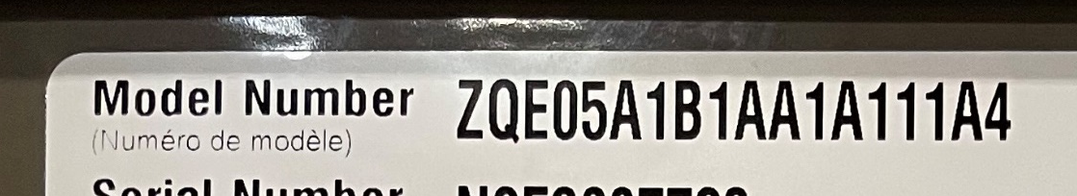
Ducted Systems Equipment Updates for R-454B
Nomenclature character change indicating R-454B
Commercial Products (Premier: TBD)
Residential Products
“K” = R-454B A/C
“W” = R-454B Heat Pump
Split system outdoor: 6th character, “E” = R-454B
Split system indoor: 5th character, “5” = R-454B
Package: 4th character “E” = R-454B
Notes:
In the example: the “Z” character indicating an R-410A A/C package unit will change to “K” with R-454B

Slide 20
Ducted Systems Equipment Updates for R-454B
Compressors: models adjusted for R-454B use
Some vendors (Copeland) only offer compressors rated solely for R-454B use
Other vendors (Danfoss) offer compressors rated for use with multiple refrigerants
Though happening around the same time, changes to the vendor-supplied piping of tandem compressor sets is not linked to the change to R-454B

Slide 21
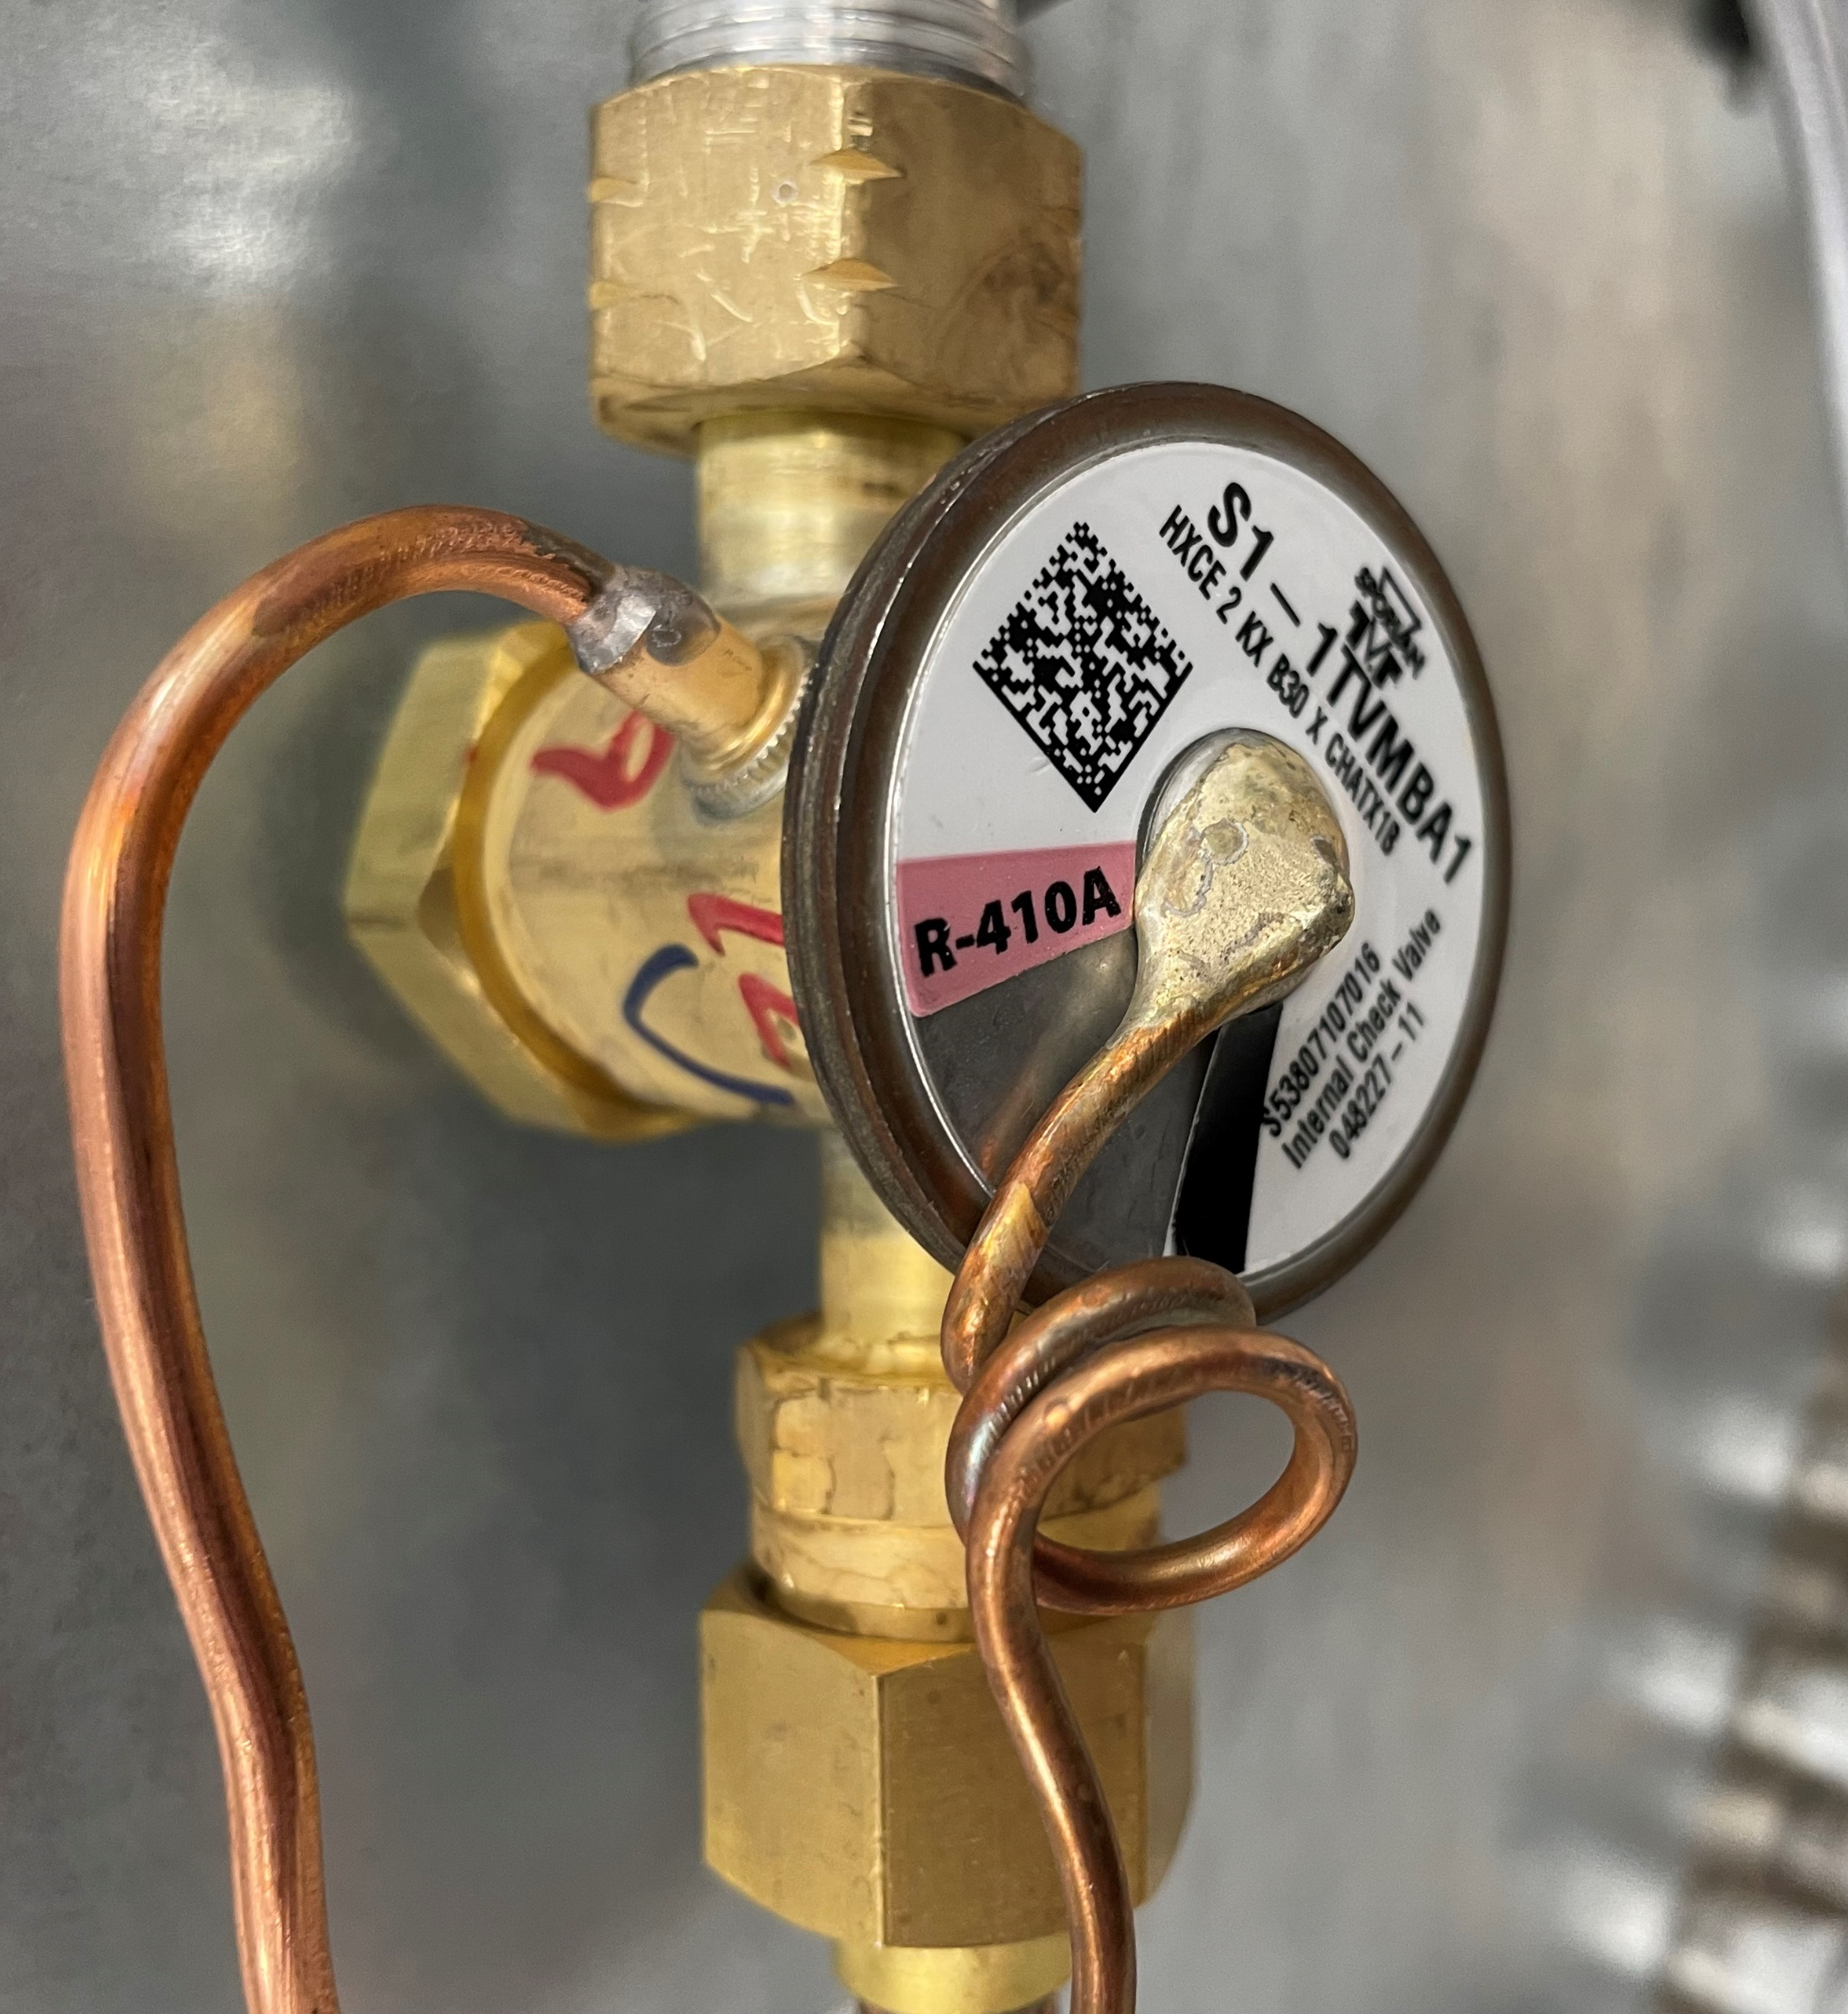
Ducted Systems Equipment Updates for R-454B
TXVs: dedicated to R-454B use
May be the same valve from the vendor – but with adjustments and Source1 part number for R-454B use
The few R-410A unit models that used orifice metering will have TXV metering for similar R-454B models

Slide 22
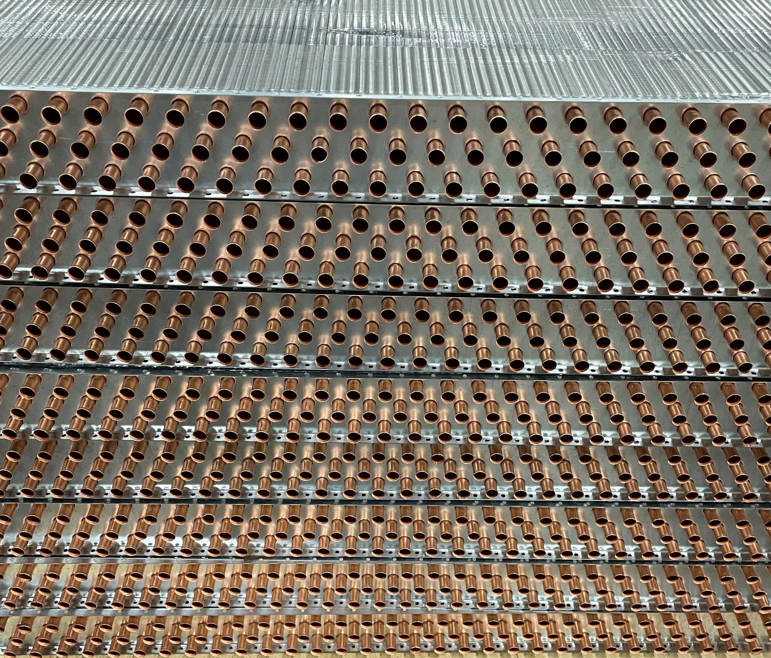
Ducted Systems Equipment Updates for R-454B
Evaporator & condenser coils:
No / minor adjustment for R-454B use – preliminary, subject to full lab tests

Slide 23
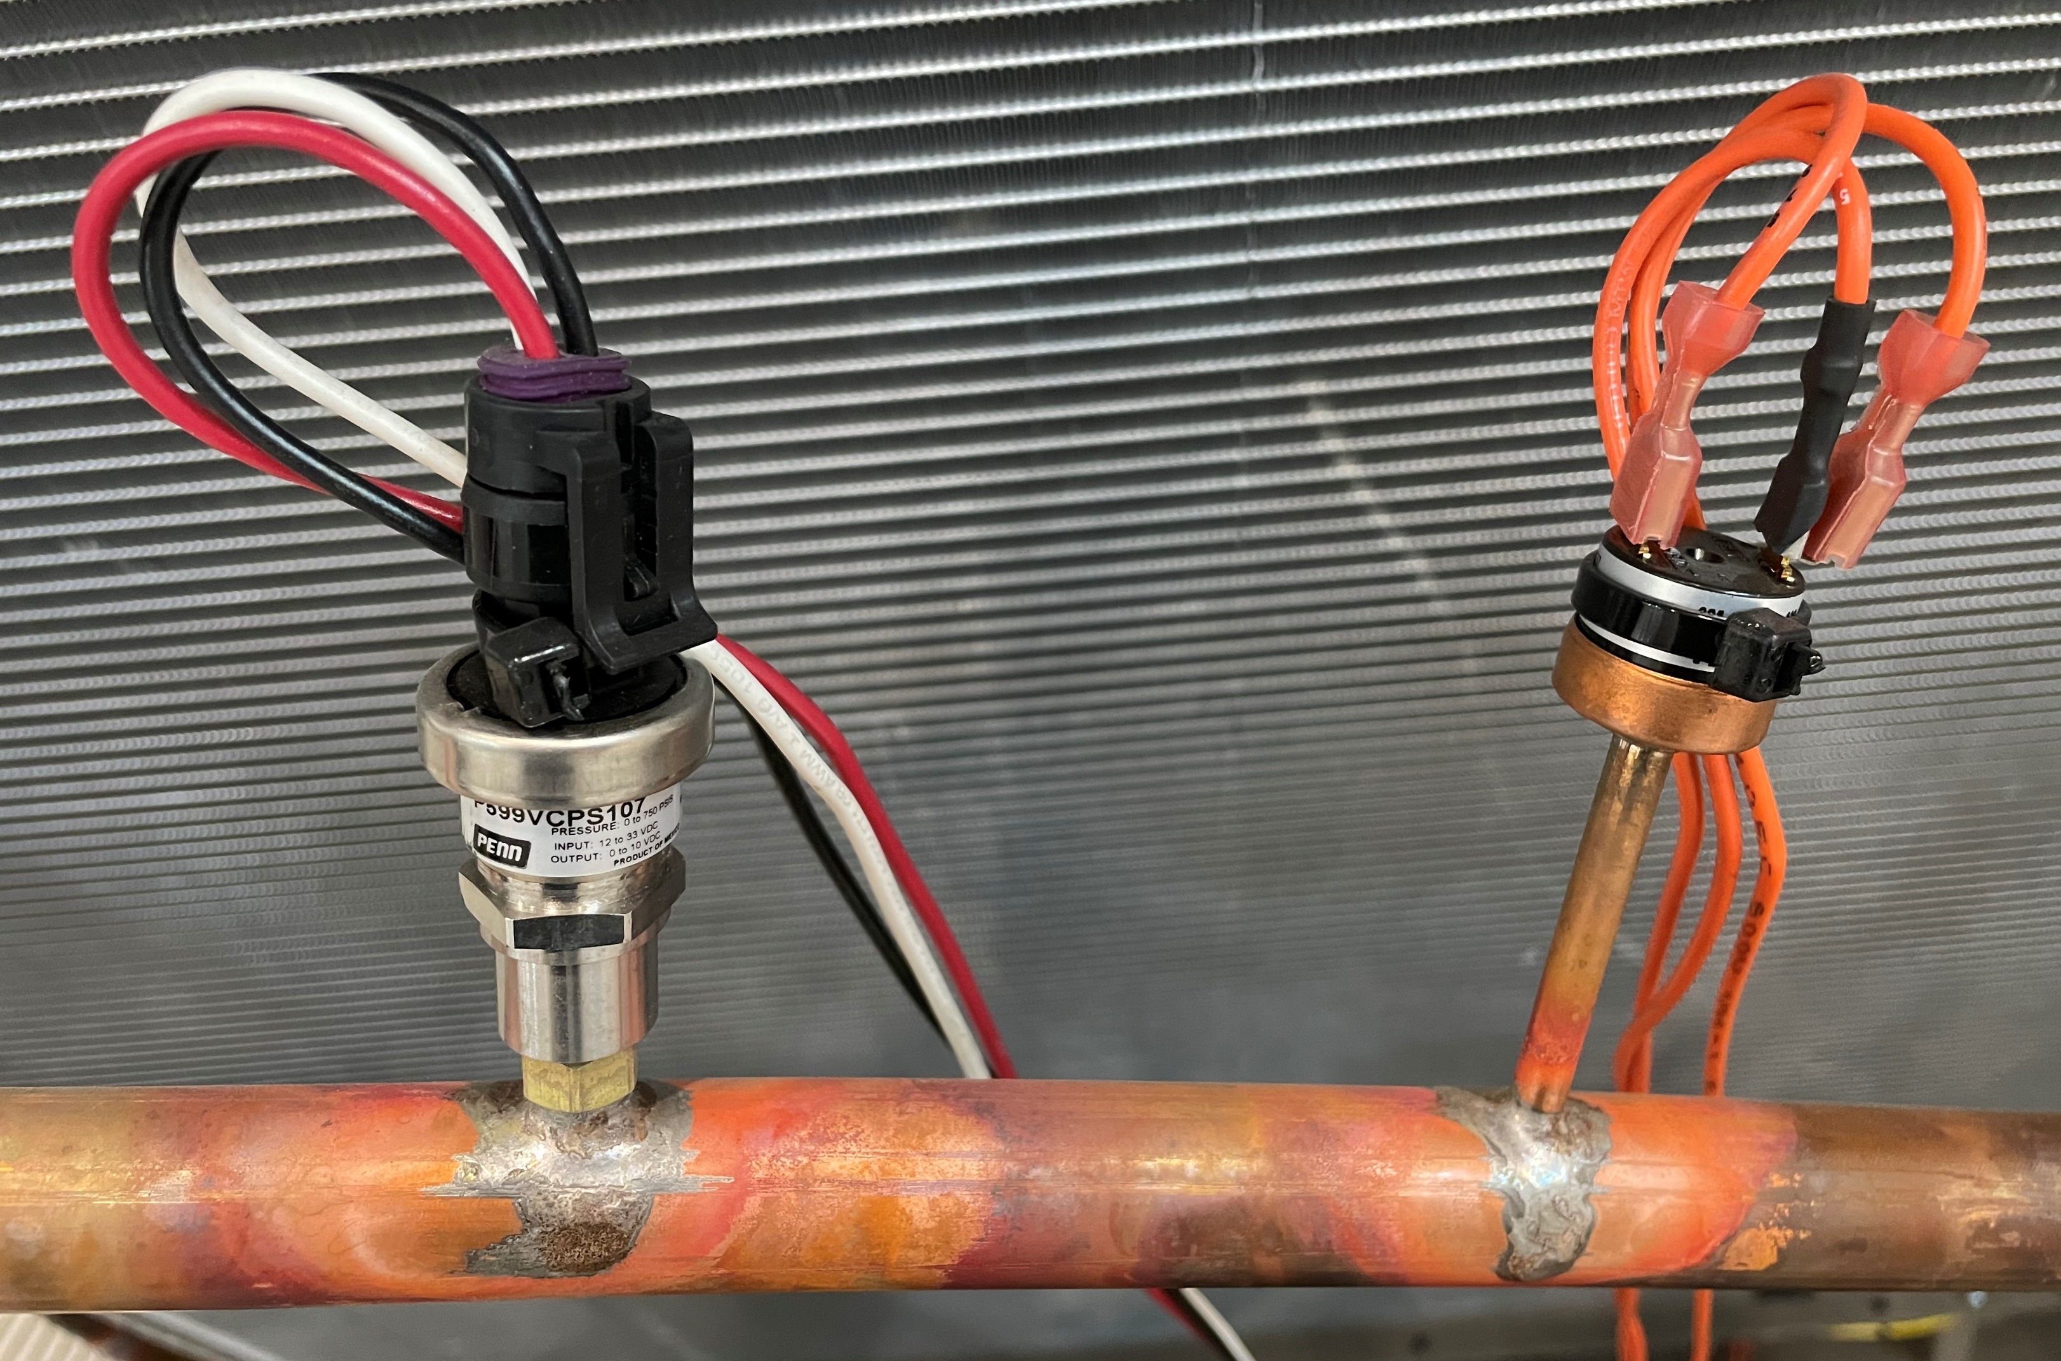
Ducted Systems Equipment Updates for R-454B
Adjustment to pressure switch cut-out settings, low ambient condenser fan speed control pressure setpoints: TBD

Slide 24
Ducted Systems Equipment Updates for R-454B
Additional labeling for R-454B: flammable refrigerant

Slide 25
Ducted Systems Equipment Updates for R-454B
Refrigerant leak detection sensors and new controller to accept refrigerant leak detection input / respond to refrigerant leak detected: details TBD
Sensor(s) strategically located (low) in the unit
Detection threshold below 25% of the Lower Flammability Limit concentration
Unit indoor blower operates to disperse refrigerant vapor in response to leak detected
Per UL standard
Notes:
Norman plant: committed to Danfoss sensors providing a binary input to the new SE control. Pre-production example of (Sanhua) sensor and control used on Wichita products

Slide 26
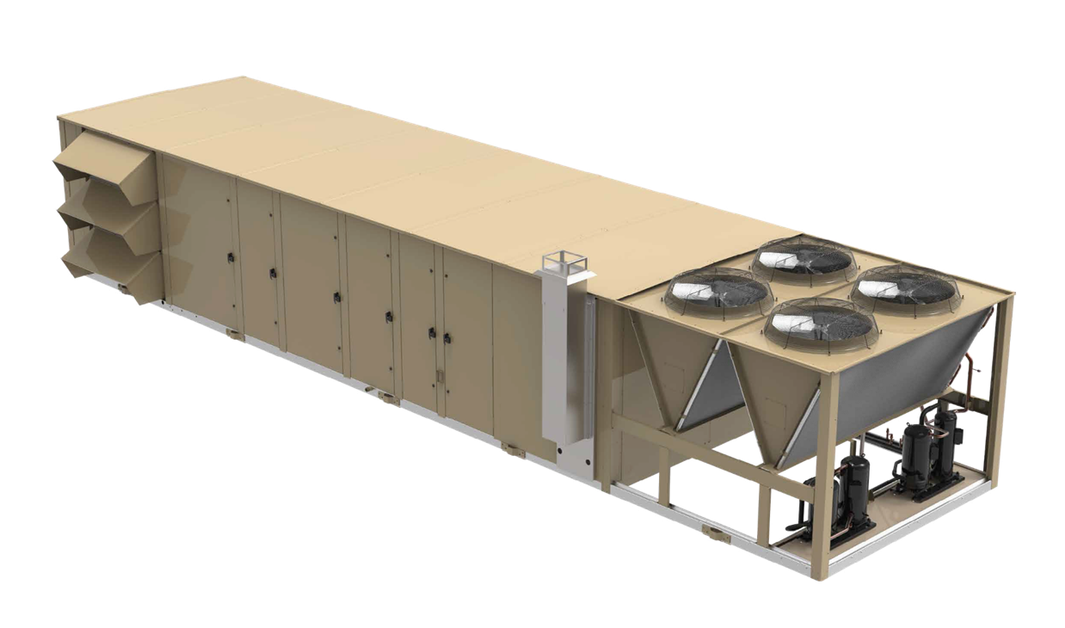
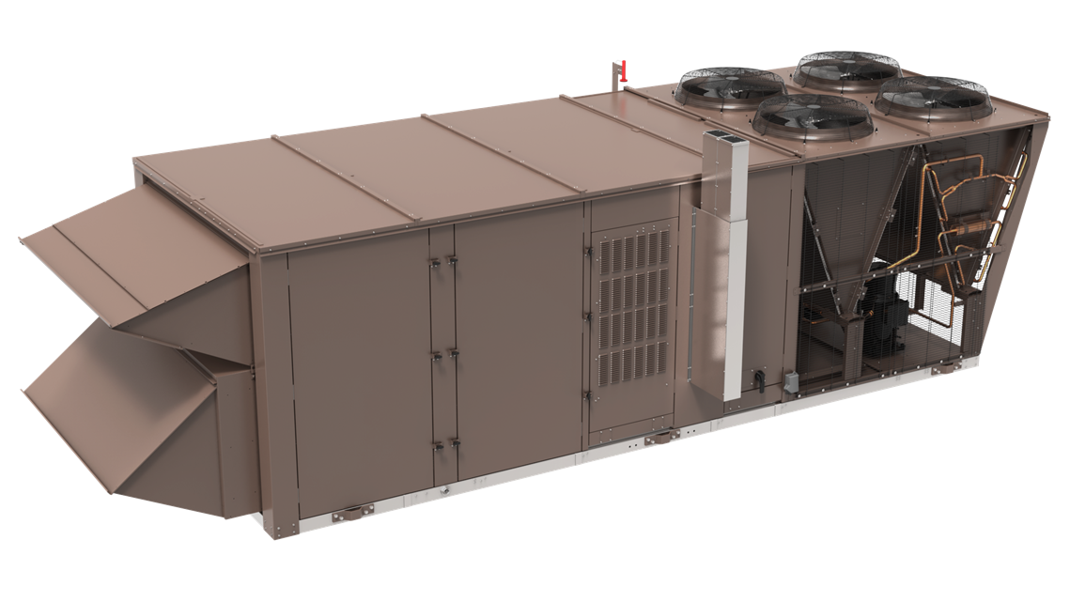
Ducted Systems Equipment Updates for R-454B
Charge limit of 26.6 lbs. (12 kg) to be below US DOT HAZMAT protocols for transportation of units
Note: Affects Premier & Select: resolution TBD

Slide 27
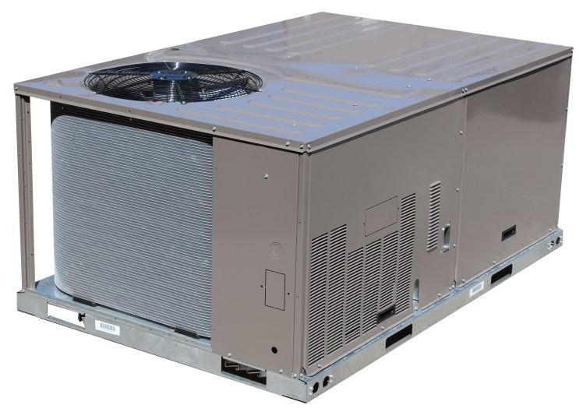
Ducted Systems Equipment Updates for R-454B
Possible for Norman-built 3 thru 5-ton package units: commercial applications only
Differing overall UL/CSA standards for residential or commercial applications – unrelated to the R-454B change
Different building and fire code standards A2L refrigerants in residential or commercial applications
Notes:
Applies mainly to 1-phase CDR. Is this a possible issue for your market?

Slide 28
R-454B Impact to Manufacturing Summary
It is clear what results are needed to comply with regulation – manufacture products with low GWP refrigerant by 1/1/2025
Work is underway to make the change to R-454B
  Engineering for R-454B is well understood though technical details are TBD at this point
  Re-certification of all products
  Manufacturing plant infrastructure for R-454B
Compressed timeline for the change to R-454B…

Slide 29
Impact to Distribution
R-410A Unit Availability Through the Transition to R-454B
From EPA publication Protecting our Climate by Reducing Use of Hydrofluorocarbons dated December 2022:
“The proposed rule would prohibit manufacture and import of products containing restricted HFCs by January 1, 2025, in most cases, and would prohibit the sale, distribution, and export of products containing restricted HFCs a year later, which in most cases would be January 1, 2026.”
  “proposed rule”: published late-2021, effective late-2023
  “most cases”: includes Ducted System products
  “restricted HFCs”: includes R-410A
  Past rule loopholes that allowed the build and sale of dry charge units are closed
In-stock R-410A units cannot be sold after 12/31/2025
  Factory and Distribution risks to stockpiling R-410A units
  Expect “last call” R-410A unit buildouts to be lean
Notes:
Not really a technical topic, but almost everyone has been impacted by recent supply chain issues

Slide 30
Regulations Impacting Distribution and HVAC Contracting
Canada: industry regulations parallel much of the discussion of US regulations
  There is variation in Provincial codes
United States:
  Significant New Alternative Policy (SNAP) Rules 20 and 21
  AIM Act
  Local transportation authority
  Local building and fire codes
Generally, details for local regulation of A2L refrigerant and units are uneven or late to be adopted
Notes:
[Apologies to Canada – the author did not thoroughly research Provincial codes] At this time, many state & local regulations for A2L are in limbo between proposal and final approval – this presentation does not attempt to provide blanket statements or definitive answers to the topic of local A2L regulations. BTW, Ducted Systems has been active on the state regulatory meetings for A2L

Slide 31
Federal Regulations – SNAP Rules 20 (2016) and 21 (2017)*
List acceptable and unacceptable refrigerants for new equipment and refrigerant retrofit
R-454B and other A2L refrigerants are only acceptable for use in new equipment
R-454B and other A2L refrigerants are unacceptable for use in retrofit
  R-454B cannot be used in existing equipment rated for R-410A
  * SNAP Rules 20 and 21 were challenged and partially vacated. Many states in the U.S. Climate Alliance organization have adopted SNAP Rules
Notes:
The SNAP Rules were some of the earliest steps for the refrigerant change. The challenges (lawsuits) muddied the refrigerant change waters and introduced delays

Slide 32
Federal Regulations – AIM Act
“…provides new authority for the U.S. Environmental Protection Agency (EPA) to address hydrofluorocarbons (HFCs) in three ways:
  (1) phasing down production and consumption,
  (2) maximizing reclamation and minimizing releases from equipment, and
  (3) facilitating the transition to next-generation technologies through sector-based restrictions.”
Notes:
Summarized here, the AIM Act is the most impactful of the federal regulations. “new authority” to a federal agency can be controversial to some…

Slide 33
Federal Regulations – AIM Act
“…provides new authority for the U.S. Environmental Protection Agency (EPA) to address hydrofluorocarbons (HFCs) in three ways:
  (1) phasing down production and consumption,
  (2) maximizing reclamation and minimizing releases from equipment, and
  (3) facilitating the transition to next-generation technologies through sector-based restrictions.”
Item (3) concerns the previously discussed manufacturing change to R-454B

Slide 34
Federal Regulations – AIM Act
“…provides new authority for the U.S. Environmental Protection Agency (EPA) to address hydrofluorocarbons (HFCs) in three ways:
  (1) phasing down production and consumption,
  (2) maximizing reclamation and minimizing releases from equipment, and
  (3) facilitating the transition to next-generation technologies through sector-based restrictions.”
Expansion on Item (1): phase down to reach “85% below baseline levels by 2036 through an allowance allocation and trading program”
Good news? – residential and commercial A/C has historically consumed a large portion of the HFC pie; allocations for the sector should be larger
Image: EPA
Notes:
Refrigerant allocations are new to the HVAC business. Lightest and darkest blue are the segments of the consumption chart for our market (almost ½ the total)

Slide 35
Federal Regulations – AIM Act
“…provides new authority for the U.S. Environmental Protection Agency (EPA) to address hydrofluorocarbons (HFCs) in three ways:
  (1) phasing down production and consumption,
  (2) maximizing reclamation and minimizing releases from equipment, and
  (3) facilitating the transition to next-generation technologies through sector-based restrictions.”
Expansion on Item (2): EPA-managed refrigerant sales, reclamation program and system leakage level standards
Bad news? – residential and commercial A/C has historically consumed a large portion of the HFC pie; there will likely be more attention to rule compliance
Image: EPA
Notes:
TBD: details of EPA refrigerant management (and the bureaucracy to support it)

Slide 36
Federal Regulations – AIM Act
“To ensure compliance with the phasedown limits, this final rule:
  Establishes an electronic tracking system for the movement of HFCs through commerce;
  Requires the use of refillable cylinders and container labeling requirements;
  Establishes administrative consequences (e.g., revocation or retirement of allowances) for noncompliance that would be in addition to any civil and criminal enforcement action;
  Requires third-party auditing of companies’ recordkeeping and reporting; and
  Provides transparency of HFC production and consumption data for the general public and participants in the market, and supports enforcement and compliance efforts.”
Source of quoted references in this and previous slides: Final Rule – Phasedown of Hydrofluorocarbons: Establishing the Allowance Allocation and Trading Program under the American Innovation and Manufacturing (AIM) Act Fact Sheet dated September 2021
Notes:
Tracking and cylinder labeling likely to be QR codes on cylinders – TBD: database for the info.
Consequences: put you out of business, fines, jail time
TBD: recordkeeping requirements and visibility of the database info

Slide 37
R-454B Topics Impacting Distribution and HVAC Contracting
“mildly flammable” is still FLAMMABLE – a cause of concern for local authorities and everyone else associated with:
Transportation of R-454B units and refrigerant cylinders
Storage of R-454B units and refrigerant cylinders
Application of R-454B systems
Installation and service of R-454B systems
Notes:
Though a poor fuel, R-454B still carries a flammable label - a flammable material raises the attention (“freaks out”) DOT, Fire Marshals and building codes. Bullet points list the activities distribution and contracting perform

Slide 38
Transport – “mildly flammable” is still FLAMMABLE
Regulation for transport of R-454B units and refrigerant is determined by the local transportation authority
Take care when travelling between areas served by different authorities
Notes:
Crossing state lines, using a ferry, military bases, etc. may have different rules for flammable gas transportation

Slide 39
Transport – “mildly flammable” is still FLAMMABLE
Regulation for transport of R-454B units and refrigerant is determined by the local transportation authority
Transportation of units: R-454B shipping charge amount up to 26.6 lbs. is exempt from US DOT HAZMAT protocols
  Note: Select & Premier charging TBD
Notes:
Note that the State DOT may have more stringent regulations

Slide 40
Transport – “mildly flammable” is still FLAMMABLE
Regulation for transport of R-454B units and refrigerant is determined by the local transportation authority
Basic guidelines for ground transport of cylinders
Must have a fire extinguisher in the vehicle
Cylinders must be strapped upright, secure from theft and tampering
Amount of A2L refrigerant (flammable gas) and vehicle ventilation are factors considered by the local transportation authority
  May have different rules for bulk or individual cylinder transport
Placards are required by the local transportation authority
Air transport of A2L cylinders or units is not approved
Notes:
Service truck with a few cylinders vs. CDL box truck with pallets of cylinders

Slide 41
Storage – “mildly flammable” is still FLAMMABLE
Regulation for storage of R-454B refrigerant and units is determined by the local fire and building codes
Basic guidelines for cylinder storage:
Must have a fire extinguisher in the vicinity
No smoking within 25 feet
Cylinders must be stored upright
If the local authority has not adopted the 2024 International Fire Code or updated NFPA standards, bulk storage of A2L refrigerant is at most
150 lbs. in an un-sprinklered warehouse
300 lbs. in a sprinklered warehouse
600 lbs. in fire-rated cabinets

Slide 42
Storage – “mildly flammable” is still FLAMMABLE
Regulation for storage of R-454B refrigerant and units is determined by the local fire and building codes
For bulk storage of A2L refrigerant, the 2024 International Fire Code and updated NFPA standards consider factors of the storage “control area”
Shelf, racked or stacked pallet storage
Fire-rated walls and entry doors
Sprinkler type and density
If the updated fire codes and standard are fully adopted by the local authority
Up to 40,000 lbs. of A2L refrigerant can be stored in each “control area”
Up to 4 “control areas” per building are allowed

Slide 43
Storage – “mildly flammable” is still FLAMMABLE
Regulation for storage of R-454B refrigerant and units is determined by the local fire and building codes
New unit storage will typically have few changes for R-454B
Codes usually consider storage of an assembled product differently than the raw components
Limited shipping charge amount
Note: Local building codes may further address leak detection and response for bulk storage of A2L refrigerant and R-454B units.
Notes:
Packaging (pallet, cardboard, plastic wrap) likely the primary flammability concern for unit storage. Leak detection and ventilation to prevent flammable concentrations of R-454B seems the most sensible way to address storage concerns

Slide 44
Application – “mildly flammable” is still FLAMMABLE
Regulation for application of R-454B units determined by the local building codes
Existing building codes that prohibit application of equipment using flammable refrigerant will need to be adjusted for A2L refrigerants
Notes:
At this time, there are still codes on the books that prevent flammable refrigerant use

Slide 45
Application – “mildly flammable” is still FLAMMABLE
Regulation for application of R-454B units determined by the local building codes
Additional refrigerant leak detection sensor(s) within the space may be required (unconfirmed spaces)
Lower Flammability Limit concentration calculations from system charge/space volume/floorspace (anticipated to be like European calcs)
  Different factors based on application, equipment location and activity in the space
    Residential or commercial
    Mechanical room, rooftop, crawlspace, etc.
    Sleeping quarters, retail space, etc.
If required, the characteristics needed for sensor(s) within the space
Location and mounted height from floor
Alarm response interlock
Audible and/or visible alarm notification
Notes:
If the charge amount is small enough / space volume is large enough that the LFL cannot be reached with a catastrophic leak, typically leak detection sensors are not required

Slide 46
Application – “mildly flammable” is still FLAMMABLE
Regulation for application of R-454B units determined by the local building codes
Confined spaces shift the “primary hazard” for R-454B to asphyxiation, with flammability a “secondary hazard”
Requirements for refrigerant leak detection and mitigation expected to be like those for existing refrigerants

Slide 47
Application – “mildly flammable” is still FLAMMABLE
Split-system piping for R-454B
Codes may/may not allow use of compression-fit piping in accessible areas
Piping in concealed spaces
Must be continuous pipe or use brazed fittings
May have more stringent leak inspection at rough-in
May have additional puncture protection requirements
Best practice: Use proper refrigerant line sizing – in some cases, R-454B can use smaller line sizes than previous refrigerants
Smaller system refrigerant charge
  Has a positive influence on the Lower Flammability Limit concentration calculations
  Reduces the need for off-cycle migration management measures
Where property sized, existing R-410A refrigerant lines can be reused for R-454B

Slide 48

R-454B Refrigerant System Service Procedures
Technician qualification – the local authority may require A2L handling training/certification in addition to “EPA 608” certification
Gloves, safety glasses and workplace PPE
Risk of frostbite from refrigerant
Risk of chemical burns from POE oil

Slide 49
R-454B Refrigerant System Service Procedures
Before servicing the refrigerant system: avoid a possible “high energy ignition source”
Inspect the area – extinguish open flames, remove any other possible ignition source. No smoking.
Lock-out/tag-out power supplies
Bleed down capacitors with a voltmeter
Allow VFDs and inverters time to discharge internal capacitors

Slide 50
R-454B Refrigerant System Service Procedures
Pay attention to low areas and confined spaces
Use a fan to ventilate and disperse refrigerant vapor
Extreme circumstances may require an oxygen mask
Bring a fire extinguisher to
the area of service
Most practical recommendation: carry general-purpose, Class A-B-C dry chemical fire extinguishers
Notes:
Fan examples: there’s a fan for most all battery-powered tool ecosystems – also is not likely to be a “high energy ignition source”

Slide 51
R-454B Refrigerant System Service Procedures
Use tools and equipment rated for A2L refrigerant use
Gauge set with low-loss hose fittings & compatible hose for the left-hand thread charging cylinder
Leak detector
Recovery machine & compatible hose for the left-hand thread recovery cylinder
Vacuum pump – with switch located away from the work zone

Slide 52
R-454B Refrigerant System Service Procedures
Replace the filter-drier any time the system is opened for repair
Use 5% or better silver content brazing alloy for installation and repair

Slide 53
R-454B Refrigerant System Service Procedures
Repair best practice for A2L refrigerants:
After refrigerant recovery > purge with dry nitrogen for 5 minutes > before brazing
  Added step to reduce/dilute residual refrigerant vapor that could ignite while brazing
Purge with dry nitrogen during brazing
Reminder: Refrigeration oil is also combustible and burns with more energy than A2L refrigerant
Pressurize and leak test the system with dry nitrogen

Slide 54
R-454B Refrigerant System Service Procedures
Evacuate the system
below 500 microns
Triple evacuation method is recommended
Pull the system down to 3000 microns (or less)
Bring the system up to 0 psig with dry nitrogen
Pull the system down to 1500 microns (or less)
Bring the system up to 0 psig with dry nitrogen
Pull the system down below 500 microns

Slide 55
R-454B Refrigerant System Service Procedures
As with other refrigerant blends, R-454B leaves the cylinder as a liquid for charging
Charge the system, either by:
Weight
Dynamic measurements
  Use bubble point data for calculation of subcooling
  Use dew point data for calculation of superheat
Charge can be “topped-off” – fractionization is not an issue

Slide 56
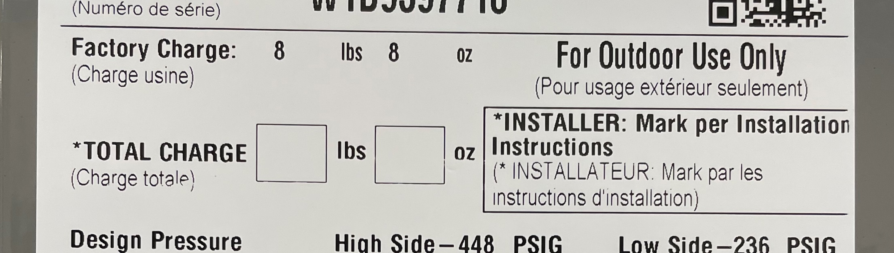
R-454B Refrigerant System Service Procedures
Baseline for:
Leakage rate limits
Lower Flammability Limit concentration calculations
Package products: done by the factory
Split systems: field responsibility

Slide 57
R-454B Refrigerant System Service Procedures
Record the amount of R-454B used (and refrigerant recovered / reclaimed)
For recordkeeping compliance and usage allocations
Notes:
Higher standards for recordkeeping may be the most significant change under the new regulations

Slide 58
DO NOTs for any Refrigerant
DO NOT introduce air or any other oxidizer to the system
Air/oxygen + refrigerant + oil + pressure + heat = a hazardous mix
DO NOT over-charge the system
Particularly for A2L refrigerants: has a negative influence on the Lower Flammability Limit concentration
DO NOT over-fill refrigerant cylinders
DO NOT expose refrigerant cylinders to temperatures above 125°F (52°C)
DO NOT mix refrigerants

Slide 59
R-454B Impact to Distribution and HVAC Contracting
Navigating though Transition
Clarify Local Uncertainties
Reach out to Localized Resources
Prepare
A2L refrigerant transport and storage
Application codes and standards for equipment with A2L refrigerant
Technician certification for A2L refrigerant handling
Transportation, fire and building code authorities
HVAC distribution and contracting organizations like HARDI, ACCA, etc.
Recordkeeping
Technician A2L handling training/certification
Tools and equipment rated for A2L refrigerant use
Response to homeowner/end-user concerns for flammable refrigerant
Notes:
Homework assignment. This presentation is more an overview and falls short on local detail. Depending on the area, some local details may be set.
Better to talk to the local authority before rather than after.
Distribution and contracting organizations have been doing battle on A2L for some time and have good insight to local concerns
Author’s view: recordkeeping is a huge operational change for the business. Don’t wait to the last minute to get certified, buy tools, etc.

Slide 60
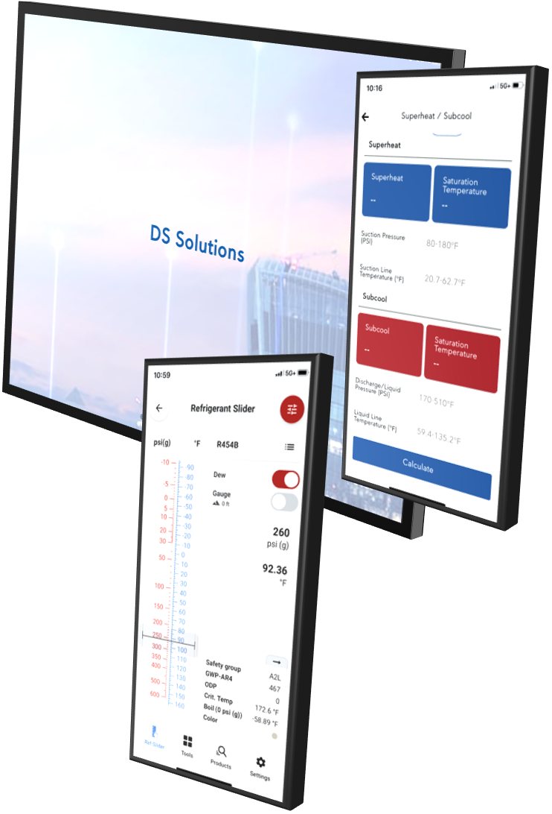
Refrigerant R-454B References and Aids
Included in handouts
  JCI Refrigerant R-454B White Paper
  R-454B MSDS sheet from Chemours
  R-454B End-user Q&A
[upcoming] in DS Solutions mobile app
  RDS (Refrigerant Detection System / Lower Flammability Limit concentration) calculator
    Also, RDS calculator online in Solution Navigator
  R-454B Superheat / Subcool calculator
[upcoming] Ducted Systems R-454B split system piping calculator
Recommended: Danfoss Ref Tools mobile app
  R-454B pressure / temperature and data in Ref Slider section

Slide 61
Questions

Slide 62
R-454B FAQs
Will R-454B explode?
Due to the slow burning velocity, it is unlikely that R-454B will explode
Could there be increased liability risk with a flammable refrigerant?
Yes, but the risk is minimized when:
  The equipment manufacturer’s instructions are followed
  There is adherence to codes and standards
  Proper installation and service procedures are used
“C’mon, I’ve been doin’ this for __ years, why’s R-454B a big deal?”
Never become complacent about proper procedures and safety practices
  Elevated need for regulatory compliance in HVAC application, installation and service
  Awareness that flammable refrigerants introduce another potential hazard to our workplace helps to keep everyone safe

Slide 63
R-454B FAQs
Is the change to R-454B temporary – will we need to go to another refrigerant in a few years?
Current indications are that R-454B will be in use for the next decade
What happens after that?
It is impossible to predict the future exactly, but the indications are that in 2036 new equipment will use refrigerant that has ultra low or 0 GWP
Why not use ultra low or 0 GWP refrigerant now?
The ultra low or 0 GWP A/C refrigerants currently available have issues
  Increased flammability (example: propane)
  Toxicity (example: ammonia)
  Performance / technology limitations (example: carbon dioxide)

Slide 64
R-454B FAQs
Are there other low GWP refrigerants for A/C?
You may see R-32, another A2L refrigerant, used in other manufacturer’s products. In the North American A/C market, Daikin is the largest adopter of R-32
Since the phasedown of HFCs / adoption of low GWP refrigerants is an international agreement, can we learn anything from overseas?
Regulations and applications differ, few lessons from overseas apply to solutions for the North American A/C market
Are refrigerant costs going to increase due to production phasedown and allocations?
Yes (there has already been R-410A cost increase), though there should be some modulation of refrigerant cost increase if the new regulations and improved practices reduce demand as intended

Slide 65
R-454B FAQs
Do we know everything about the change to R-454B?
No, this is a significant HVAC industry change in a short timeframe – anticipate more discovery as experience is gained
  Uncertainties about regulations during this transitional period need clarified
  Lessons to be learned from widespread use of R-454B & A2L refrigerants
  Updates will be made as details become available
  Ask that everyone stay vigilant in proper procedures and safety practices
Notes:
We don’t know what we don’t know. Did the development team for the original foam coffee cup think a “contents are hot” label was needed? – it’s almost certain R-454B will have a “coffee cup moment”

Slide 66
Thank You

